Slide 1





Sri Adichunchanagiri Shikshana Trust®
SJB INSTITUTE OF TECHNOLOGY
#67,BGS Health & Education City,
Dr. Vishnuvardhana Road,Kengeri,Bengaluru-560060.
KARNATAKA,INDIA.
DIVYA D
1ST SEMESTER
‘A’ SECTION , ‘CSE’ BRANCH

Slide 2

INDEX
INTRODUCTION TO CORROSION
CLASSIFICATION OF CORROSION
ELECTROCHEMICAL THEORY OF CORROSION
TYPES OF CORROSION
CORROSION PENETRATION RATE
PREVENTION METHODS
SUMMARY
This Photo by Unknown Author is licensed under CC BY-NC-ND

Slide 3
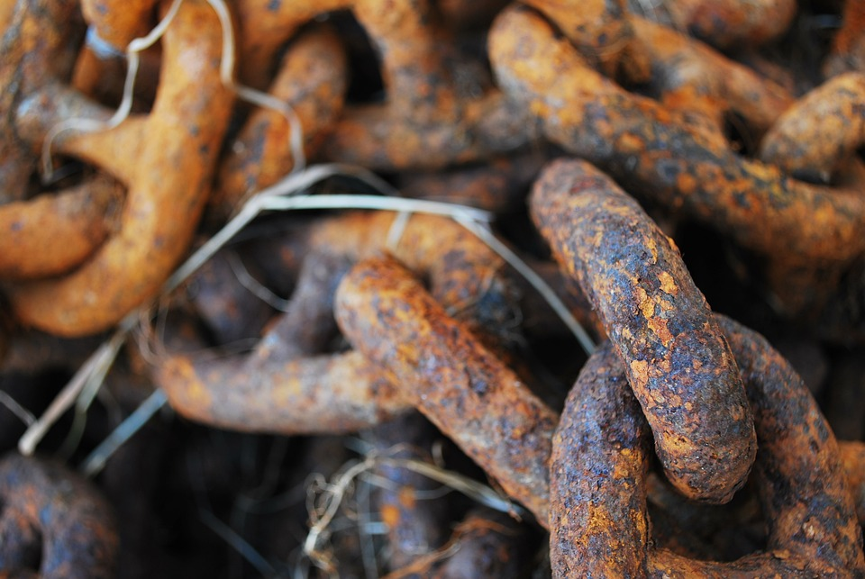
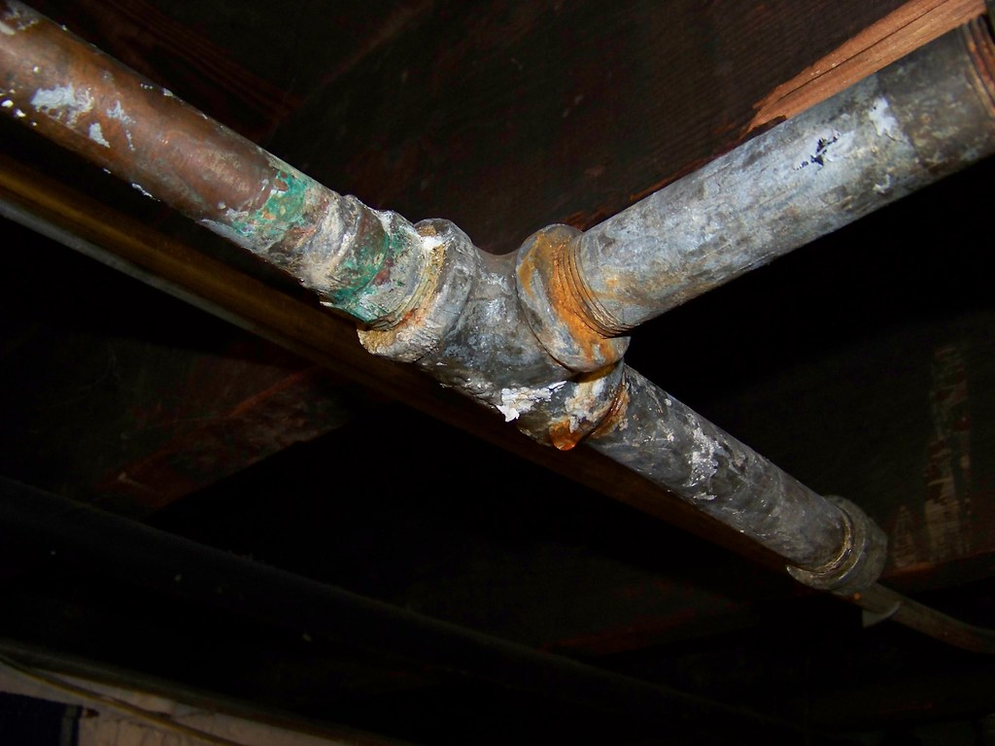
HEARD OF CORROSION?
Biological term for corrosion?
The deterioration or the destruction of the metal through the chemical or electrochemical attack by the surrounding environment is known as corrosion.
?
Examples
Reddish brown scales and green scales on the surfaces are the indication of corrosion stages.
CLASSIFICATION :
Dry corrosion: Destruction of metal through chemical attack in the absence of moisture. The gases involved are SO2,CO2 etc.
Wet corrosion : Deterioration of metal or a substance through chemical attack in the presence of moisture.

Slide 4
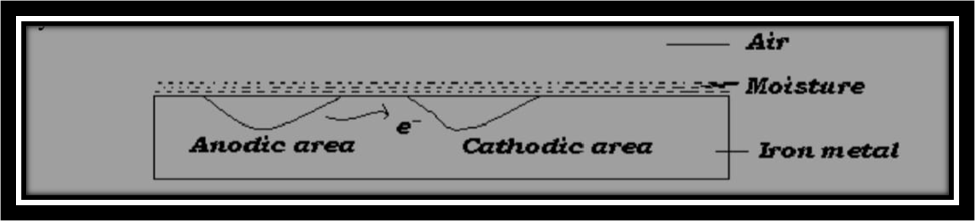
Electrochemical theory of corrosion
According to electrochemical theory, corrosion of metals occurs due to the following changes, when they are exposed to the environment.
1) A large number of minute galvanic cells are formed which acts as anodic and cathodic areas.
2) At anode the metal undergoes oxidation and electrons are liberated which migrates towards cathodic region
3) Oxygen of the atmosphere undergoes reduction at cathodic area in the presence of moisture forming hydroxyl ions at the cathode.

Slide 5
Anodic reactions: At anode the metal undergoes oxidation-liberating electrons
M Mn+ + ne-
(metal) (electrons)
Ex: when iron is exposed to the environment it undergoes oxidation as
Fe Fe2+ + 2e-
Cathodic reactions:- The electrons released at anode migrate to the cathodic area and reduces oxygen to hydroxyl ions.
The different cathodic reactions are,
a) In acidic medium: In acidic medium and in the absence of oxygen, hydrogen ions are reduced to hydrogen gas.
2H+ + 2e - H2
b) In alkaline and in the absence of O2. If the solution is alkaline and in the absence of oxygen the cathodic reaction is,
2 H2O + 2e- 2OH - + H2
c) In neutral and aerated medium: when the solution is neutral and aerated, hydroxyl ions are formed as follows.
2 H2O + O2 + 4e- 4OH

Slide 6

d) Formation of corrosion product: The hydroxyl ions migrate towards anode and react with metal ions (Mn+ ions) and forms corrosion product.
In the case of iron OH- reacts with Fe2+ ions and forms an insoluble hydrated ferric oxide known as brown rust.
2Fe+ + 4OH - 2Fe (OH)2
2Fe (OH) 2+ O2 + (n-2) H 2O (Fe 2O 3. nH2O) Rust
This Photo

Slide 7
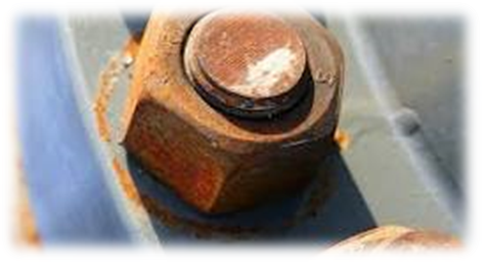
Types of corrosion
A)DIFFERNTIAL METAL CORROSION: It occurs when two dissimilar metals (galvanic couples) are in contact with each other in a corrosive conductive medium; a potential difference is set up resulting in a galvanic current. The two metals differ in their tendencies to undergo oxidation. The more reactive metal will experience severe corrosion while the noble metal will be protected from corrosion. Higher the difference in potential, higher the rate of corrosion.

Slide 8
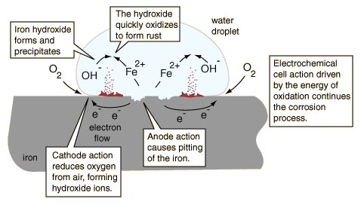
B)DIFFERENTIAL AERATION CORROSION : takes place when there is an uneven supply of oxygen to areas of the same metal component. It is a type of electrochemical corrosion that affects metals such as steel and iron. The varying concentration of oxygen creates an anode and a cathode on the metal's surface. Oxidation then occurs because an anode and a cathode have been established on the surface.

Slide 9
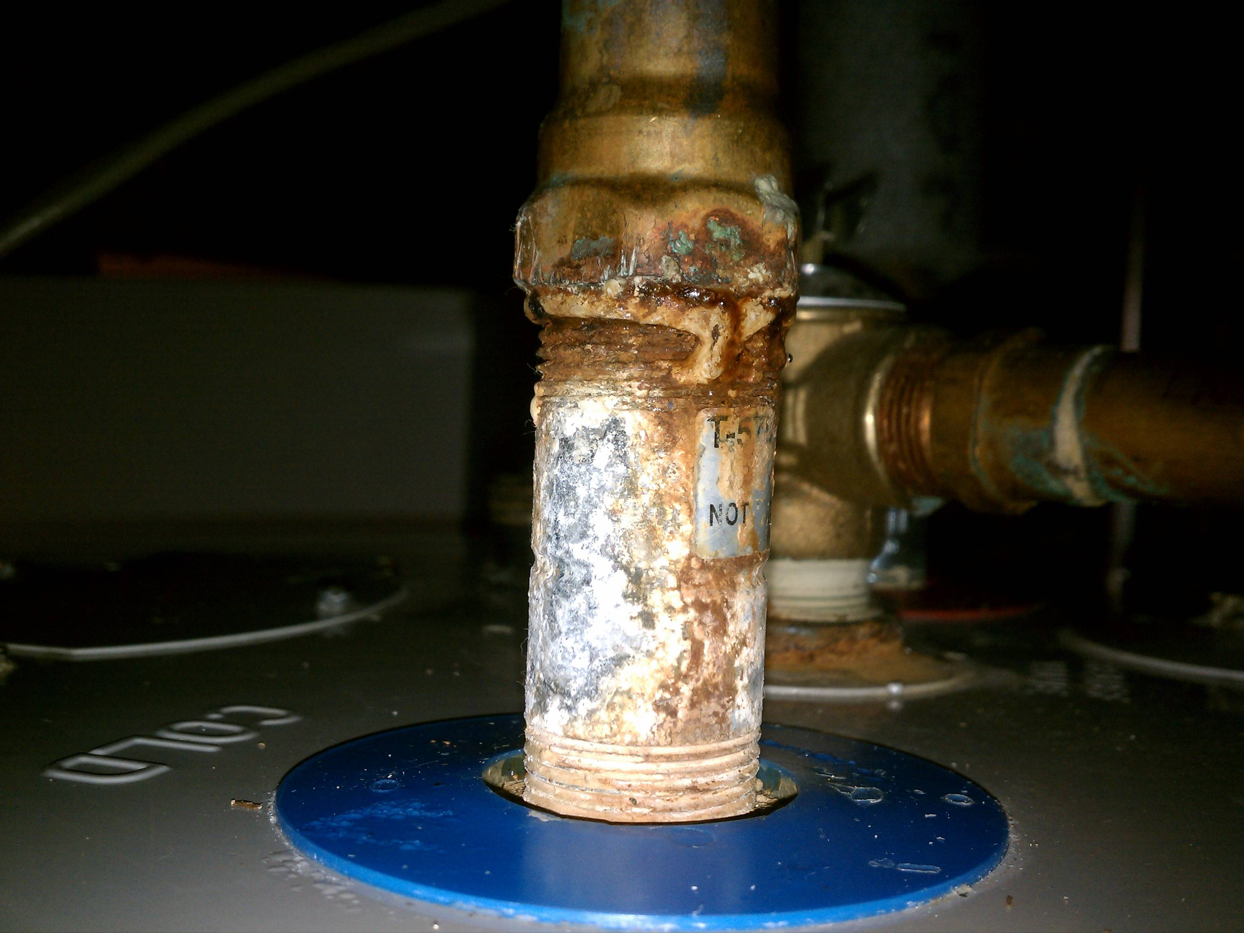
Water line corrosion : Waterline corrosion is a type of oxidation process that can happen to materials in contact with water. Waterline corrosion occurs when one portion of a base material is submersed in the water and another portion is in contact with the air. The waterline corrosion takes place due to the formation of differential oxygen concentration cells. When water is stored in a metallic tank, it is observed that the metal below the waterline gets corroded. It is because the water below the waterline is poorly oxygenated and acts as an anode. The metal above the waterline is highly oxygenated and acts as a cathode.

Slide 10
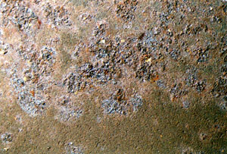
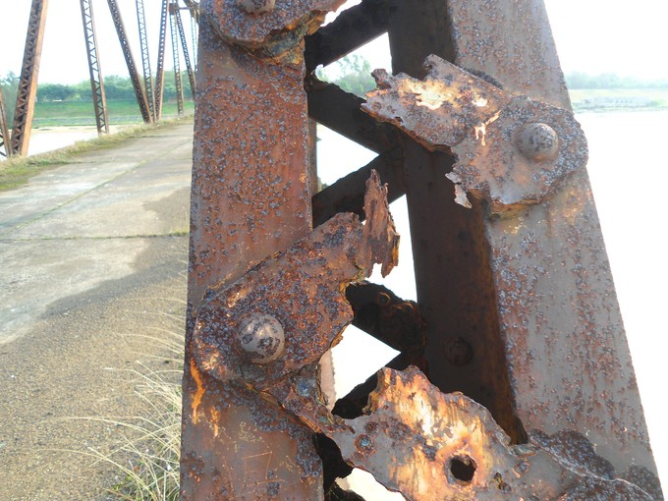
2. Pitting corrosion : Pitting corrosion is a localized form of corrosion by which cavities or "holes" are produced in the material. Pitting is considered to be more dangerous than uniform corrosion damage because it is more difficult to detect, predict and design against. Corrosion products often cover the pits. The concentration of aggressive ion, pH, and inhibitor concentration are some of the environmental factors that affect pitting. Alloy composition: Composition and microstructure greatly influence pitting tendency of alloys .
This Photo by Unknown Author is licensed under CC BY-SA

Slide 11
METHODS TO PREVENT CORROSION :
Use non-corrosive metals, such as stainless steel or aluminium.
Make sure the metal surface stays clean and dry.
Use drying agents.
Use a coating or barrier product such as grease, oil, paint or carbon fibre coating.
Lay a layer of backfill, for example limestone, with underground piping.
INORGANIC COATING
Anodising of aluminium
2. METAL COATING
Galvanization
Tinning process
3. CATHODIC PROTECTION
Sacrificial anodic method

Slide 12

Corrosion occurs at a particular rate.
The rate at which the metal gets deteriorated through chemical or electrochemical attack by the surrounding environment is ‘CPR’.
The speed at which the deterioration spreads in the metal.
The rate of corrosion can be calculated using ,
CPR =KW/RHO AT
where, K=constant(mpy=534,mmpy= 87.6)
W= weight of the substance(in terms of mg)
A= area of the substance(mpy= inch^2, mmpy= cm^2)
T= time taken for the reaction(in terms of hours)

Slide 13


